Slide 1




Emna HANNACHI
Tunisia
Institut Pasteur
Ph.D student
emna.hn@gmail.com

Slide 2




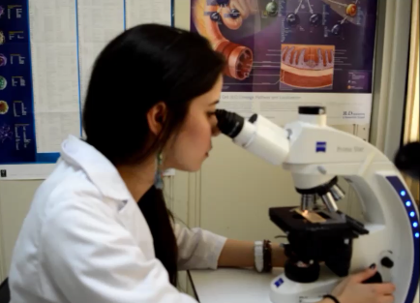
Youth and revolution in Tunisia
Tunisian Women: A Success Story

Slide 3
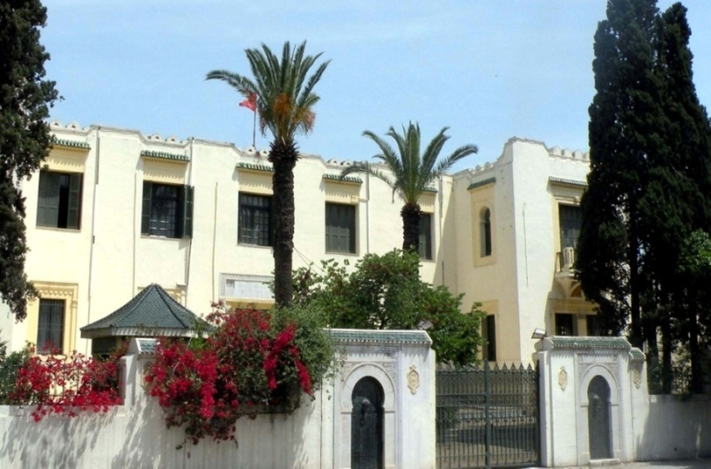
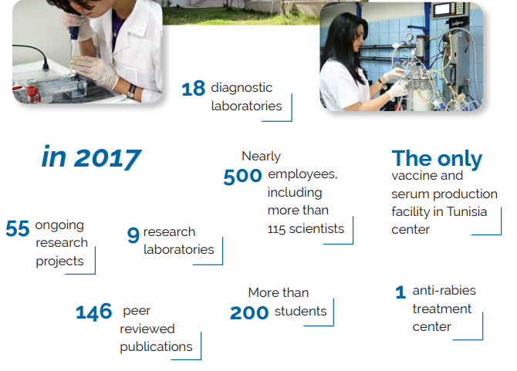
www.pasteur.tn
Laboratory of Medical Parasitology, Biotechnology
and Biomolecules Immuno-Biotechnology Groupe
Institut Pasteur de Tunis
The Institut Pasteur de Tunis (IPT) is a public health institution.
IPT is commissioned to carry out epidemiological and clinical studies, biomedical investigations, as well as research activities pertaining to human and animal health.
IPT also produces vaccines and sera.
IPT is member of the Institut Pasteur International Network, which consists of 33 institutes throughout the world.

Slide 4
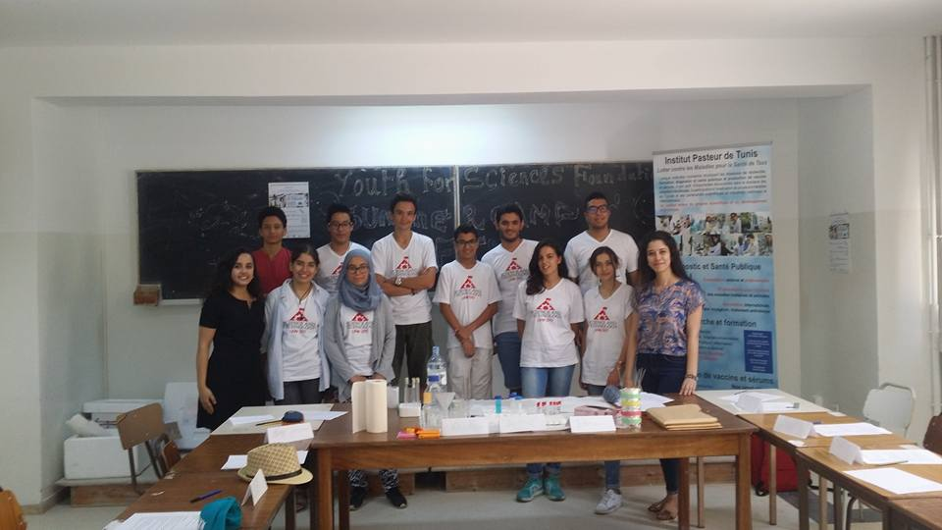

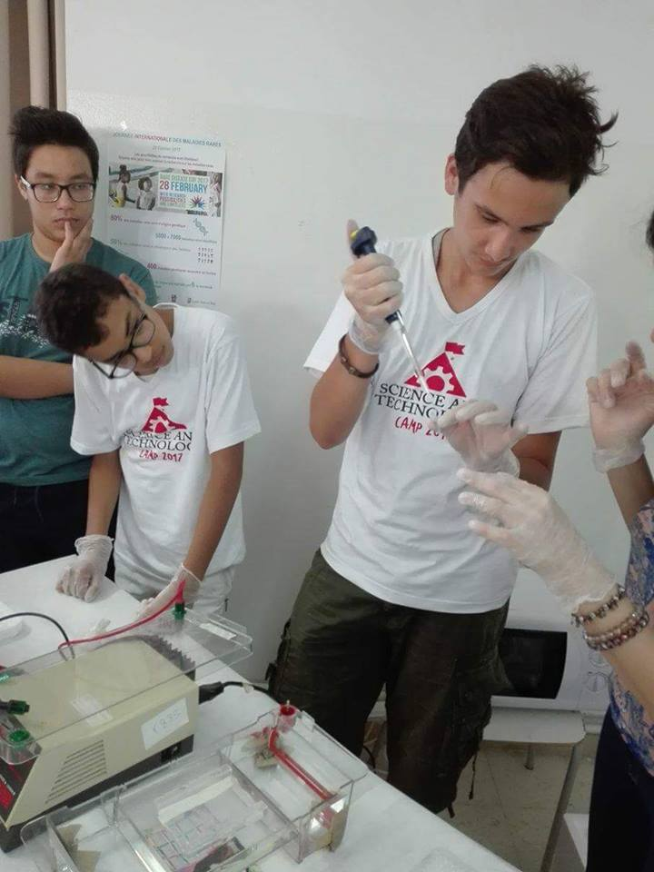
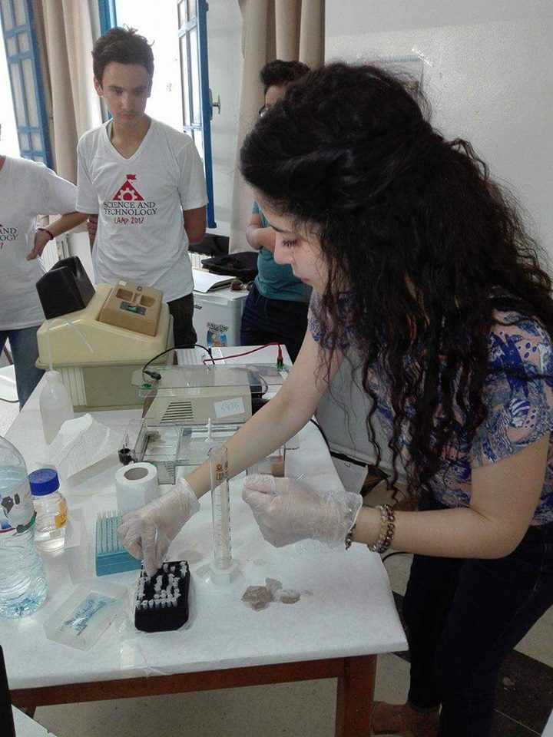

Scientific vulgarization
Associative life
Leadership and management in global Heath
Youth for science association Summer Camp Teaching high school students about DNA
Secretary general of the Young Researchers Association of the Institut Pasteur of Tunis
In charge of communication of The 1st International Symposium of Young Researchers 2016
President of Scientific committee
Organization of events
Appointement in lab
Short videos : the activities, innovation and research shared on open science .
Notes:
to transmit that knowledge by
sparking the interest of the public and making the science relevant to the
every-day life.

Slide 5

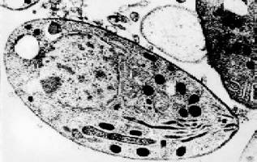


Immunodeficient patient:
Mortality
Newborns:
Intracranial calcification
Fever, anemia, microcephaly
Deafness
Congenital toxoplasmosis:
Spontaneous abortion
Premature birth
Diagnostic methodes:
Advantages and disadvantages
Cost, sensitivity, specificity,
ease of use, ect.
Toxoplasmosis :
Engineering of Variable
Fragment of Antibodies
for Therapeutic and
Immunodiagnostic Use
of theToxoplasma
gondii Parasite
Toxoplasma gondii
Is an obligate
intracellular parasite
that infects 30% of
the world’s population
Economic and health problems: Humans and animals
Notes:
Espacially the serological tests

Slide 6

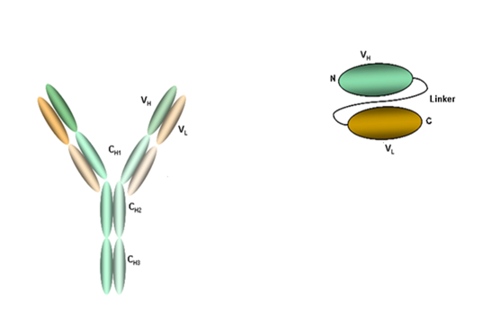
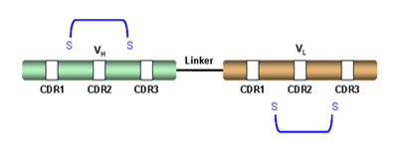
scFv
Advantages
Of scFv
scFv
Small size (29 kDa)
Little immunogenic
Stable and non-glycosylated
Production in bacteria systems
Intrinsic properties can be modified by mutagenesis
Basic modules for the formation of multivalent fragments and / or fusion proteins
Liaison covalente
peptide linker
(Gly₄ Ser)₃
linker peptide
(Gly4 Ser)3
IgG

Slide 7
scFv :Therapeutic use
scFv :Diagnostic use
Inhibition of invasion process of T. gondii
C
Internalisation
scFv anti-SAG1
B
Penetration
A
Attachement
The major surface antigen of T. gondii: SAG1
SAG1 is the ligand which initiates the invasion of tachyzoites into the host cell
Engineering of Variable Fragment Antibodies anti-SAG1 for Therapeutic and Immunodiagnostic Use of
Toxoplasma gondii the Parasite

Slide 8

Currently researching
1
Cloning of the scFvSG15 gene into pET22b+ vector
Sequencing
2
Procaryotic Expression and purification analyses
Cloning scFvSG15-AP fusion protein into pLIP6 vector : genetic fusion with an engineered bacterial alkaline phosphatase;
3
Bifunctionality of the recombinant fusion protein: ELISA test, Immuno-capture ELISA test, Dot blot assay, immuno-imprint
Fluorescence microscopy:
ELISA : spectrofluorometer (4-MUP, 4 methylumbelliferyl phosphate)
Notes:
Testing activities reveal a specific antigenic recognition of the Toxoplasma gondii major surface antigen SAG1.

Slide 9

Perspectives
in vitro activity
the potential of the developed scFvSG15-PA conjugate for the detection of SAG1 in brain impressions, and cell infected by T gondii
in vivo activity
the potential of the developed scFvSG15-PA conjugate for the detection of tachyzoites in different sources, such as milk, contaminated water, and body fluids.
Therapeutic use
Diagnostic use
the use of this recombinant colorimetric fusion
protein (scFv-AP) in different assays for a one-step detection of Toxoplasma gondii.
the potential of the developed scFvSG15 monmeric and or dimeric for blocking the procesus of invasion of T gondii
Application of Biacore technologty : recombinant protein/ Sag1 interaction, binding affinities…
Application of Flow Cytometry for Assessing Soluble scFvSG15 Activities and Detecting Antigens in Solution

Slide 10


Long Term scientific goals:
Development of a rapid Diagnostic tool to detect the T.gondii parasite infections in different samples.
Use of this study (Engineering of Variable Fragment of
Antibodies) as a model for others parasites and infectious
diseases.
Get a postdoctoral position
Writ a project and get funding : Protein Engineering , Design, expression and characterization of in vitro immunodiagnostic reagents for infectious diseases

Slide 11
Difficulties in doing research in Tunisia
Economic Problems: The Ministry's budget for scientific research
in 2017 has been set at 300 MTD (107 M€) , of which 90.7 MTD
(33 M€) is allocated directly to research Structures.
The time taken to receive a product order
The lack of international collaborations.
The lack of equipment and materials

Slide 12

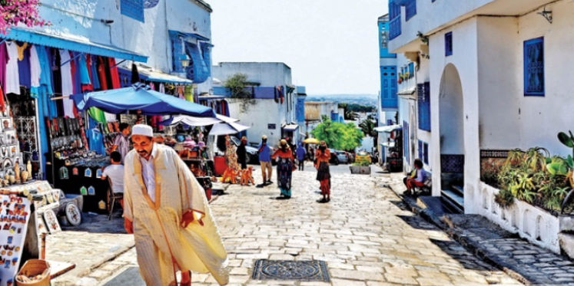

Thank you for your attention

